Slide 1
SDP REVIEW 2
NO.170

Slide 2
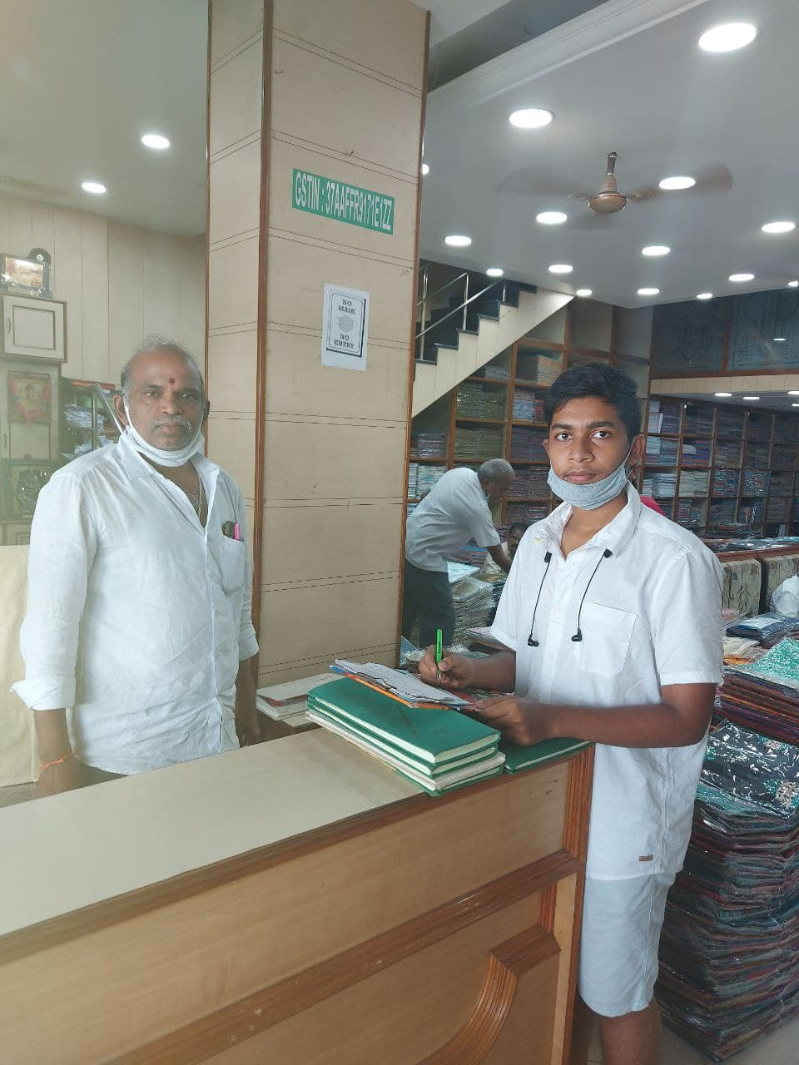
dESIGN
In our app we have a simple and appropriate design for the resource planning of shopping mall .
We have added use cases according to the users requests which we have done through review in many enterprises .
From review we came across following use cases which will be discussed below.

Slide 3
Billing
When we scan the barcode present on the dress chosen by the customer the full details of the dress will be presented on our system screen (dress type, cost including taxes).
In the billing it shows the number of dresses bought and offers and discounts that apply (if any).
3) Then the type of payment must be selected by the customer to complete the money transaction and saves it.

Slide 4
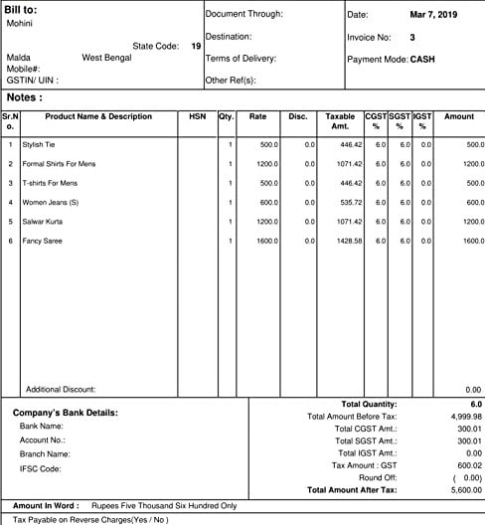

Slide 5
Staff details
In this we can view the list of the staff working.
Their official details ( Name , contact number, copy of any government related identity)
their working hours per the each day and their salaries accordingly.

Slide 6
Finance and login
1 ) This helps us to view and manage our financial status per day .( the amount spent on the dress and the profit earned per the particular day)
2 ) This is where we enter our details to access the application and use it , this info can be saved and can be accessed the app without entering again ( user choice).

Slide 7
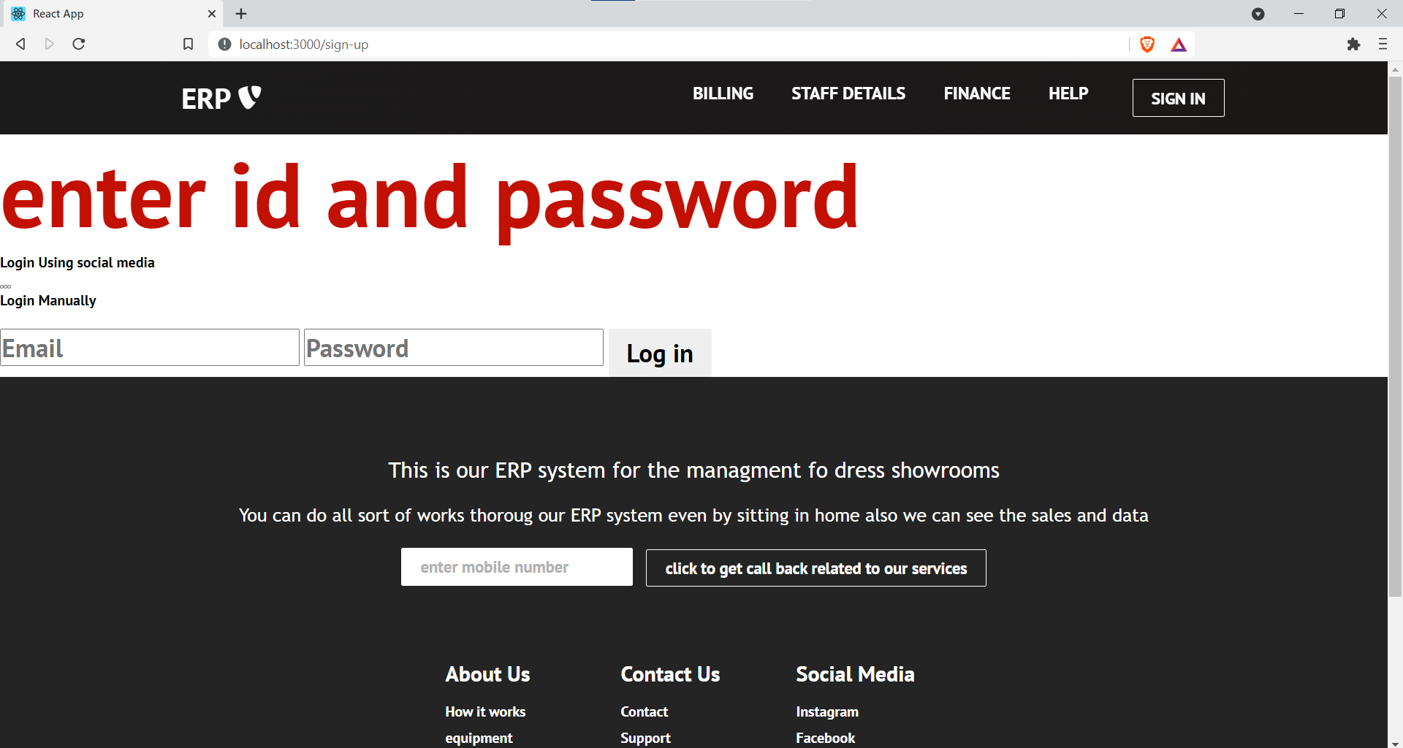

Slide 8
Help
1 ) The “Help” option is used to dispay the full details of the app or website to us and solves any queries related to it. ( For example where do I find a particular detail in this app, contact number and information about this application creators, etc).
2) This may also help on how to use this app if you are online rookie.

Slide 9
